Slide 1
Session 37 : Data storage
using SQLite 1
Module 4.3 : Android

Slide 2
Learning Objectives
At the end of the session successful participants will be able to
Work with SQLite Programming
Implement SQLiteOpenHelper
Create tables in SQLiteDatabse
Insert Data
Update Data
Delete Data

Slide 3
Android Persistency – SQL Database
SQL Database
Using SQL databases in Android
Android (as well as iPhoneOS) uses an embedded standalone program called sqlite3 which can be used to:
Create a database, Define SQL tables, Indices, Queries, Views, | Triggers INSERT rows, Delete rows, Change rows, Run queries and Administer a SQLite database file

Slide 4
Android Persistency – SQL Database
SQL Database
Using SQLite
SQLite implements most of the SQL-92 standard for SQL.
It has partial support for triggers and allows most complex queries (exception made for outer joins).
SQLITE does not implement referential integrity constraints through the foreign key constraint model.

Slide 5
Android Persistency – SQL Database
SQL Database
Using SQLite
SQLite uses a relaxed data typing model.
Instead of assigning a type to an entire column, types are assigned to individual values. This is similar to the Variant type in Visual Basic.
Therefore it is possible to insert a string into numeric column and so on.
Documentation on SQLITE available at http://www.sqlite.org/sqlite.html
Good GUI tool for SQLITE available at: http://sqliteadmin.orbmu2k.de/

Slide 6
Android Persistency – SQL Database
SQL Database
How to create a SQLite database?
Method 1:
public staticSQLiteDatabase.openDatabase(
Stringpath, SQLiteDatabase.CursorFactoryfactory, intflags )
Open the database according to the flags OPEN_READWRITE OPEN_READONLY CREATE_IF_NECESSARY . Sets the locale of the database to the the system's current locale.

Slide 7
Android Persistency – SQL Database
SQL Database
How to create a SQLite database?
Parameters
Path | To database file to open and/or create
Factory | An optional factory class that is called to instantiate a cursor when query is called, or null for default
Flags | To control database access mode
Returns | The newly opened database
Throws | SQLite Exception if the database cannot be opened

Slide 8
Android Persistency – SQL Database
SQL Database
Example 1: Create a SQLite Database
package cis493.sqldatabases;
import android.app.Activity;
import android.database.sqlite.*;
import android.os.Bundle;
import android.widget.Toast;
public classSQLDemo1 extendsActivity {
SQLiteDatabasedb;
@Override
publicvoidonCreate(Bundle savedInstanceState) {
super.onCreate(savedInstanceState);
setContentView(R.layout.main);

Slide 9
Android Persistency – SQL Database
SQL Database
Example 1: Create a SQLite Database
// filePathis a complete destination of the form
// "/data/data/<namespace>/<databaseName>"
// "/sdcard/<databasename>“
try{
db= SQLiteDatabase.openDatabase(
"/data/data/cis493.sqldatabases/myfriendsDB",
null,
SQLiteDatabase.CREATE_IF_NECESSARY);
db.close();
}
catch(SQLiteException e) {
Toast.makeText(this, e.getMessage(), 1).show();

Slide 10
Android Persistency – SQL Database
SQL Database
Example 1: Create a SQLite Database
}
}// onCreate
}//class

Slide 11
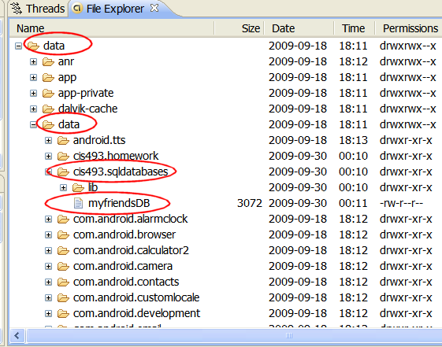
Android Persistency – SQL Database
SQL Database
Example 1: Create a SQLite Database
Android’s System Image
Device’s memory

Slide 12
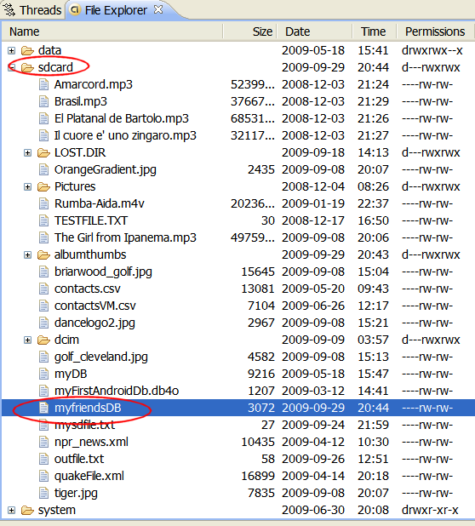
Android Persistency – SQL Database
SQL Database
Example 1: Create a SQLite Database
Creating the database file in the SD card
Using:
db= SQLiteDatabase.openDatabase(
"sdcard/myfriendsDB", null,
SQLiteDatabase.CREATE_IF_NECESSARY);

Slide 13

Android Persistency – SQL Database
SQL Database
Warning
Beware of sharing issues. You cannot access other people’s database resources (instead use Content Providers or SD resident DBs).
An SD resident database requires the Manifest to include:
<uses-permission android:name="android.permission.WRITE_EXTERNAL_STORAGE" />
NOTE: SQLITE (as well as most DBMSs) is not case sensitive.

Slide 14
Android Persistency – SQL Database
SQL Database
Example 2: Create a SQLite Database
An alternative way of opening/creating a SQLITE database in your local Android’s data space is given below
SQLiteDatabasedb = this.openOrCreateDatabase(
"myfriendsDB", MODE_PRIVATE, null);
Where:
The assumed prefix for the database stored in the devices ram is: "/data/data/<CURRENT_namespace>/databases/". For instance if this app is created in a namespace called “cis493.sql1”, the full name of the newly created database will be: “/data/data/cis493.sql1/databases/myfriendsDB”.

Slide 15
Android Persistency – SQL Database
SQL Database
Example 2: Create a SQLite Database
An alternative way of opening/creating a SQLITE database in your local Android’s data space is given below
SQLiteDatabasedb = this.openOrCreateDatabase(
"myfriendsDB", MODE_PRIVATE, null);
Where:
This file could later be used by other activities in the app or exported out of the emulator (adbpush…) and given to a tool such as SQLITE_ADMINISTRATOR (see notes at the end).

Slide 16
Android Persistency – SQL Database
SQL Database
Example 2: Create a SQLite Database
An alternative way of opening/creating a SQLITE database in your local Android’s System Image is given below:
SQLiteDatabasedb = this.openOrCreateDatabase("myfriendsDB2", MODE_PRIVATE, null);
Where:
“myFriendsDB2” is the abbreviated file path. The prefix is assigned by Android as:
/data/data/<app namespace>/databases/myFriendsDB2.

Slide 17
Android Persistency – SQL Database
SQL Database
Example 2: Create a SQLite Database
An alternative way of opening/creating a SQLITE database in your local Android’s System Image is given below:
SQLiteDatabasedb = this.openOrCreateDatabase("myfriendsDB2", MODE_PRIVATE, null);
Where:
MODE could be: MODE_PRIVATE, MODE_WORLD_READABLE, and MODE_WORLD_WRITEABLE. Meaningful for apps consisting of multiples activities.

Slide 18
Android Persistency – SQL Database
SQL Database
Example 2: Create a SQLite Database
An alternative way of opening/creating a SQLITE database in your local Android’s System Image is given below:
SQLiteDatabasedb = this.openOrCreateDatabase("myfriendsDB2", MODE_PRIVATE, null);
Where:
null refers to optional factory class parameter (skip for now)

Slide 19
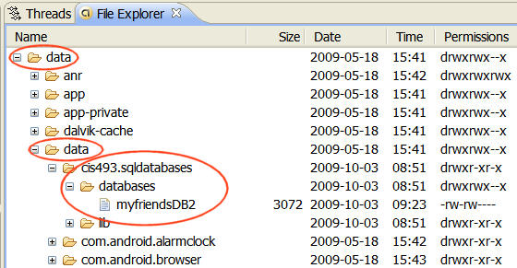
Android Persistency – SQL Database
SQL Database
Example 2: Database is saved in the device’s memory

Slide 20
Android Persistency – SQL Database
SQL Database
Executing SQL commands on the Database
Once created, the database is ready for normal operations such as:
Creating Altering Dropping resources (tables, indices, triggers, views, queries etc.) Administrating database resources (containers, users, …).

Slide 21
Android Persistency – SQL Database
SQL Database
Executing SQL commands on the Database
Action queries and Retrieval queries represent the most common operations against the database.
A retrieval query is typically a SQL-Select command in which a table holding a number of fields and rows is produced as an answer to a data request.
An action query usually performs maintenance and administrative tasks such as manipulating tables, users, environment, etc.

Slide 22
Android Persistency – SQL Database
SQL Database
Transaction Processing
Transactions are desirable because they contribute to maintain consistent data and prevent unwanted losses due to abnormal termination of execution.
In general it is convenient to process action queries inside the protective frame of a database transaction in which the policy of “complete success or total failure” is transparently enforced.
This notion is called: atomicity to reflect that all parts of a method are fused in an indivisible-like statement.

Slide 23
Android Persistency – SQL Database
SQL Database
Transaction Processing
The typical Android way of running transactions on a SQLite Database - (db SQLite Database)
db.beginTransaction();try{//perform your database operations here ...db.setTransactionSuccessful(); //commit your changes}catch(SQLiteException e) {//report problem }finally{db.endTransaction();}
Transaction is defined between: beginTransaction and endTransaction. You need to issue the setTransactionSuccessful() call to commit any changes. The absence of it provokes an implicit rollback; consequently the database is reset to the state previous transaction

Slide 24
Android Persistency – SQL Database
SQL Database
Creating-Populating a Table
SQL Syntax for the creating and populating of a table looks like this:
recID | name | Phone
1 | AAA | 555
2 | BBB | 777
3 | CCC | 999
create table tblAMIGO(recIDinteger PRIMARY KEY autoincrement,
name text, phone text );
insert into tblAMIGO(name, phone) values ('AAA', '555' );

Slide 25
Android Persistency – SQL Database
SQL Database
Creating-Populating a Table
We will use the execSQL(…)method to manipulate SQL action queries. The following example creates a new table called tblAmigo.
The table has three fields: a numeric unique identifier called recID, and two string fields representing our friend’s name and phone. If a table with such a name exists it is first dropped and then created anew. Finally three rows are inserted in the table.

Slide 26
Android Persistency – SQL Database
SQL Database
Creating-Populating a Table
db.execSQL("create table tblAMIGO("
+ " recIDinteger PRIMARY KEY autoincrement, "
+ " name text, “
+ " phone text ); " );
db.execSQL( "insert into tblAMIGO(name, phone) values ('AAA', '555' );" );
db.execSQL( "insert into tblAMIGO(name, phone) values ('BBB', '777' );" );
db.execSQL( "insert into tblAMIGO(name, phone) values ('CCC', '999' );" );
Note: for presentation economy we do not show the entire code which should include a transaction frame.

Slide 27
Android Persistency – SQL Database
SQL Database
Creating-Populating a Table: Comment
The field recID is defined as PRIMARY KEY of the table. The “autoincrement” feature guarantees that each new record will be given a unique serial number (0,1,2,…).
The database data types are very simple, for instance we will use:
text | date
varchar | time
integer | timestamp
float | blob
numeric | boolean, and so on…

Slide 28
Android Persistency – SQL Database
SQL Database
Creating-Populating a Table: Comment
In general, any well-formed SQL action command (insert, delete, update, create, drop, alter, etc.) could be framed inside an execSQL(…) method.
You should make the call to execSQL inside of a try-catch-finally block. Be aware of potential SQLiteException situations thrown by the method.

Slide 29
Android Persistency – SQL Database
SQL Database
Creating-Populating a Table
Note:
SQLITE uses an invisible field called ROWID to uniquely identify each row in each table.
Consequently in our example the field: recID and the database ROWID are functionally similar.

Slide 30
Android Persistency – SQL Database
SQL Database
Asking SQL Questions
Retrieval queries are SQL-select statements.
Answers produced by retrieval queries are always held in an output table.
In order to process the resulting rows, the user should provide a cursor device. Cursors allow a row-by-row access of the records returned by the retrieval queries.

Slide 31
Android Persistency – SQL Database
SQL Database
Asking SQL Questions
Android offers two mechanisms for phrasing SQL-select statements:
rawQueries and simplequeries. Both return a database cursor.
Raw queries take for input a syntactically correct SQL-select statement. The select query could be as complex as needed and involve any number of tables (remember that outer joins are not supported).
Simple queries are compact parametized select statements that operate on a single table (for developers who prefer not to use SQL).

Slide 32
Android Persistency – SQL Database
SQL Database
SQL Select Syntax
SQL-select statements are based on the following components
(see http://www.sqlite.org/lang.html)
Select field₁, field₂, … , field_{n}
From table₁, table₂, … , table_{n}
where( restriction-join-condition )
order by fieldn1, …, fieldnm
group by fieldm1, … , fieldmk
having (group-condition)
Note: The first two lines are mandatory, the rest is optional.

Slide 33
Android Persistency – SQL Database
SQL Database
Example: SQL Select Syntax
Select LastName, cellPhone
From ClientTable
Where state = ‘Ohio’
order by LastName
Select city, count(*) as TotalClients
From ClientTable
group by city

Slide 34
Android Persistency – SQL Database
SQL Database
Example: Using RawQuery (version 1)
Consider the following code fragment
Cursor c1 = db.rawQuery(
"select count(*) as Total from tblAMIGO",null);

Slide 35
Android Persistency – SQL Database
SQL Database
Example - 1: Using RawQuery (version 1)
The previous rawQuery contains a select-statement that counts the rows in the table tblAMIGO.
The result of this count is held in a table having only one row and one column. The column is called “Total”.
The cursor c1 will be used to traverse the rows (one!) of the resulting table.

Slide 36
Android Persistency – SQL Database
SQL Database
Example - 1: Using RawQuery (version 1)
Fetching a row using cursor c1requires advancing to the next record in the answer set.
Later the (singleton) field total must be bound to a local Java variable. We soon will show how to do that.

Slide 37
Android Persistency – SQL Database
SQL Database
Example - 2: Using Parametized RawQuery(version 2)
Using Arguments: Assume we want to count how many friends are there whose name is ‘BBB’ and their recID> 1. We could use the following construction
String mySQL= "select count(*) as Total "
+ " from tblAmigo"
+ " where recID> ?"
+ " and name = ?";
String[] args= {"1", "BBB"};
Cursor c1 = db.rawQuery(mySQL, args);

Slide 38
Android Persistency – SQL Database
SQL Database
Example - 2: Using Parametized RawQuery(version 2)
Using Arguments: After the substitutions are made the resulting SQL statement is:
select count(*) as Total from tblAmigo where recID> 1 and name = ‘BBB’
Partial matching using expressions such as: name like ‘?%’ are not working now. Wait for an Android fix! (see similar issue: http://code.google.com/p/android/issues/detail?id=2619)
Similarly String.format(…) fails to properly work in cases such as: name like ‘%s%’. Note the second % is the SQL wild-character symbol, not an invalid string format!

Slide 39
Android Persistency – SQL Database
SQL Database
Example - 2: Using RawQuery(version 3)
Using Arguments: Assume we want to count how many friends are there whose name is ‘BBB’ and their recID> 1. We could concatenate pieces of the string. Special care around (single) quoted strings.
String[] args= {"1", "BBB"};
String mySQL= " select count(*) as Total "
+ " from tblAmigo"
+ " where recID> " + args[0]
+ " and name = '" + args[1] + "'";
Cursor c1 = db.rawQuery(mySQL, null);

Slide 40
Android Persistency – SQL Database
SQL Database
Simple Queries
Simple queries use a template implicitly representing a condensed version of a typical (non-joining) SQL select statement. No explicit SQL statement is made.
Simple queries can only retrieve data from a single table.
The method’s signature has a fixed sequence of seven arguments representing:
The table name | The columns to be retrieved | The search condition (where-clause)
Arguments for the where-clause | The group-by clause | Having-clause
The order-by clause

Slide 41
Android Persistency – SQL Database
SQL Database
Simple Queries
The signature of the Android’s simple query method is:
query(Stringtable,
String[]columns,
Stringselection,
String[]selectionArgs,
StringgroupBy,
Stringhaving,
StringorderBy)

Slide 42
Android Persistency – SQL Database
SQL Database
Simple Queries
Example 1: Query the EmployeeTable, find the average salary of female employees supervised by 123456789. Report results by Dno. List first the highest average, and so on, do not include depts. having less than two employees.
String[] columns =
{"Dno","Avg(Salary) as AVG"};
String[] conditionArgs=
{"F","123456789"};
Cursorc = db.query("EmployeeTable", columns, "sex = ? And superSsn= ? " , conditionArgs, "Dno", "Count(*) > 2",
"AVG Desc“ );

Slide 43
Android Persistency – SQL Database
SQL Database
Simple Queries
Example 2: The following query selects from each row of the tblAMIGO table the columns: recID, name, and phone. RecID must be greater than 2, and names must begin with ‘B’ and have three or more letters.
String [] columns = {"recID", "name", "phone"};
Cursor c1 = db.query("tblAMIGO", columns, "recID> 2 and length(name) >= 3 and name like 'B%' ", null, null, null,
"recID" );
inttheTotal= c1.getCount();

Slide 44
Android Persistency – SQL Database
SQL Database
Simple Queries
The String array columns holds the name of fields to be selected.
The retrieval condition is explicitly provided.
Several fields are missing in the call including: selectionArgs, group-by, and having-clause. Instead the null value is used to signal their absence.
The last argument indicates the result should be sorted on “recID” sequence.
String [] columns = {"recID", "name", "phone"}; Cursor c1 = db.query("tblAMIGO", columns, "recID> 2 and length(name) >= 3 and name like 'B%' ", null, null, null, "recID" );

Slide 45
Android Persistency – SQL Database
SQL Database
Simple Queries
Example 3: In this example we will construct a more complex SQL select statement.
We are interested in tallying how many groups of friends whose recID> 3 have the same name. In addition, we want to see ‘name’ groups having no more than four people each.
A possible SQL-select statement for this query would be something like:
select name, count(*) as TotalSubGroup from tblAMIGO
where recID> 3 group by name having count(*) <= 4;

Slide 46
Android Persistency – SQL Database
SQL Database
Simple Queries
Example 3: An Android solution for the problem using a simple template query follows.
String [] selectColumns= {"name", "count(*) as TotalSubGroup"};
String whereCondition= "recID> ?";
String [] whereConditionArgs= {"3"};
String groupBy= "name";
String having = "count(*) <= 4";
String orderBy= "name";
Cursor myCur= db.query("tblAMIGO", selectColumns,
whereCondition, whereConditionArgs, groupBy, having, null);

Slide 47
Android Persistency – SQL Database
SQL Database
Simple Queries
Observations:
The selectColumns array indicates two fields name which is already part of the table, and TotalSubGroup which is to be computed as the count(*) of each name sub-group.
The symbol ?in the whereCondition is a place-marker for a substitution. The value “3” taken from the whereConditionArgs is to be injected there.

Slide 48
Android Persistency – SQL Database
SQL Database
Simple Queries
Observations:
The groupBy clause uses ‘name’ as a key to create sub-groups of rows with the same name value. The having clause makes sure we only choose subgroups no larger than four people.

